Slide 1
Coursera Capstone
IBM Data Science Professional Certificate
Exploration of Eateries in Kolkata
By: Riddhiman Basu
April 2020

Slide 2
Business Problem
For anyone who visits Kolkata as a tourist or for work assignments:
How does he/she choose a cheap place which offers good food?
How can the person find out the highly rated restaurants in Kolkata?
What good options for lunch/dinner are present near the locality where the person is staying?

Slide 3
Approach
This project explores various eateries in Kolkata and attributes the data based on user ratings and average price.
A map of the venues with specific color attributes has been plotted to highlight their position, and information about these venues.
This enables any visitor to take a quick glance and decide what place to visit.

Slide 4
Target Audience
Tourists from abroad and other cities, as well as people who visit Kolkata on work assignments. This analysis could help them pick out restaurants which fit their budget and also near their current locality.
In addition, travel portals like TripAdvisor may also use such data to recommend restaurants for visitors.

Slide 5
Data Requirements
Data will be acquired from two main sources:
Foursquare API
Name, Category, Latitude, Longitude
Zomato API
Name, Address, Rating, Price Range, Price for two, Latitude, Longitude

Slide 6
Data Processing
Erroneous data like venues showing as 0 were removed
Foursquare and Zomato Data were combined by calculating the difference between latitude and longitude. Venues having difference less than 0.0004 were considered as one.
Average price for all the eateries were calculated from zomato data

Slide 7
Methodology
Identified places where many venues are located so that any visitor can go to one place and make a choice amongst various venue options.
Explored and plotted areas that are high rated and low rated.
Also plotted the locations of high and low priced venues.
Clustered the available data on venues to identify common patterns.

Slide 8
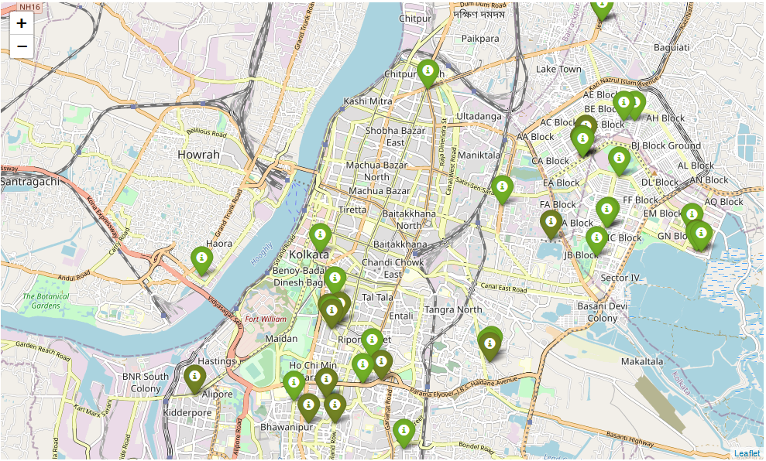
Analysis
Plot of venues based on ratings – Red for Lowest to Dark Green for Highest

Slide 9
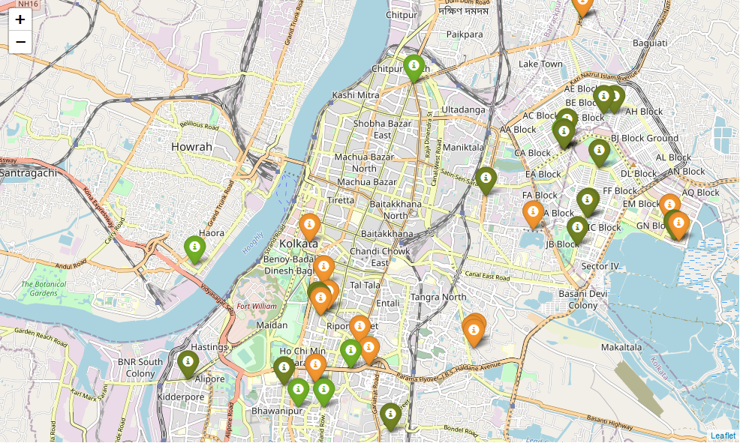
Analysis – Contd
Plot of venues based on price range – Green for Lowest to Red for Highest

Slide 10
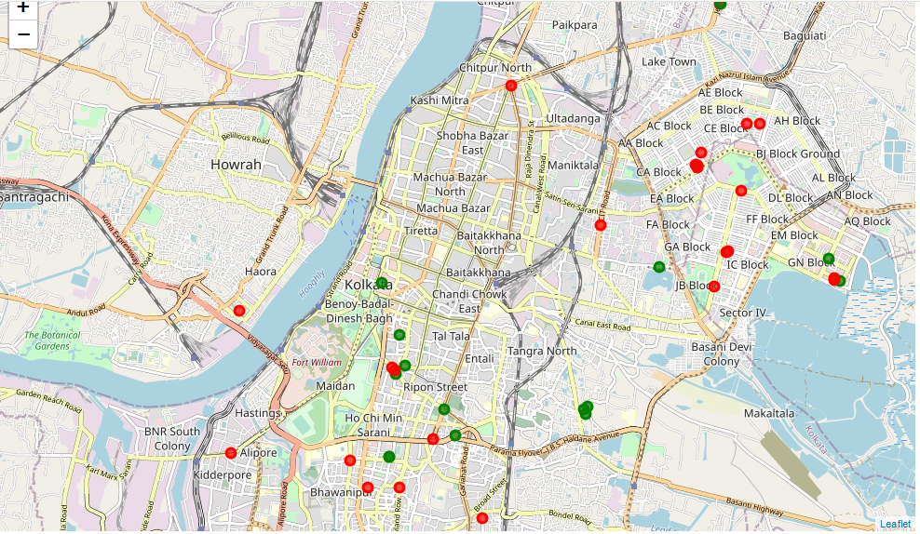
Analysis – Contd
The data was clustered into two clusters – Red and Green

Slide 11
Analysis – Contd
Cluster 0 – Green had mean price range of 3.06 and rating spread around 4.06.
Cluster 1 – Red had mean price range of 1.62 and rating spread around 3.95

Slide 12
Results and Discussions
There is a concentration of venues around Central Kolkata and Salt Lake City
Majority of the venues have ratings between 3.4 and 4.2
Majority of the venues have a price range of Rs 200 to Rs 400 for one person
The first cluster has few venues spread throughout the city as well as concentrated around Central Kolkata which are relatively high priced and have an average rating of 4.06
The second cluster has many venues concentrated around Salt Lake City which are moderately priced and have average rating of 3.95.

Slide 13
Conclusion
If one is looking for cheap places with moderately high ratings (close to 4.0), one should check out Salt Lake City.
If one is looking for the best places, with the highest rating but might also carry a relatively higher price tag, one has to visit Central Kolkata, as well as may explore parts of North and South Kolkata.
A company can use this information to build up an online website/mobile application, to provide users with up to date information about various venues in the city based on the search criteria (name, rating and price).

